Slide 1
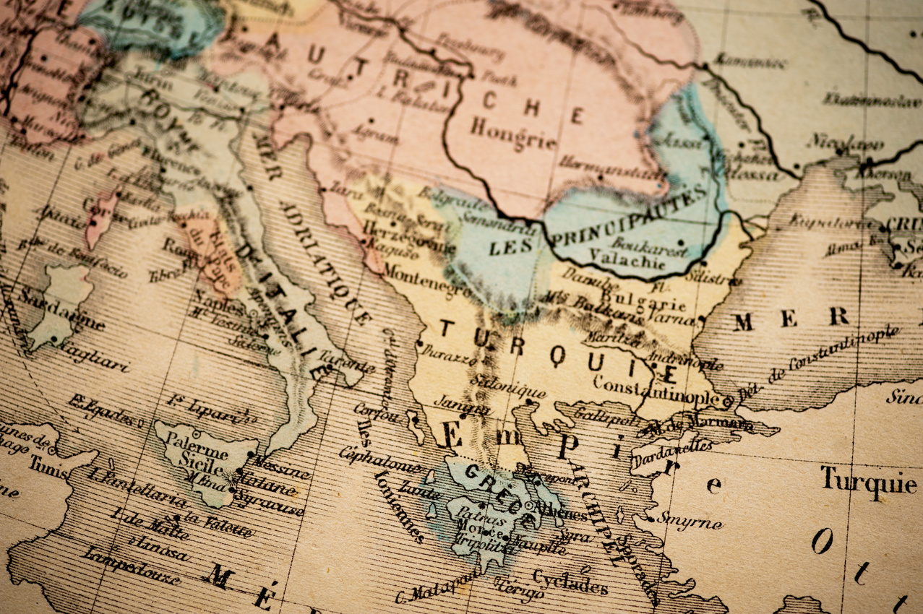







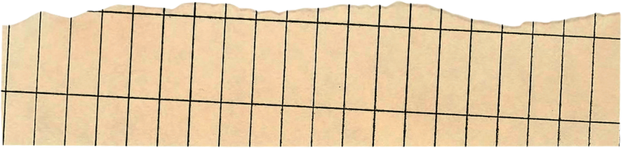
Applications of
Partial Differential
Equations
in Geography
Chahel Gupta
Roll Number: C049
Batch: B2
Course: BTI(Computers), Semester 6

Slide 2
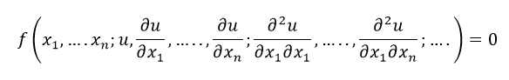

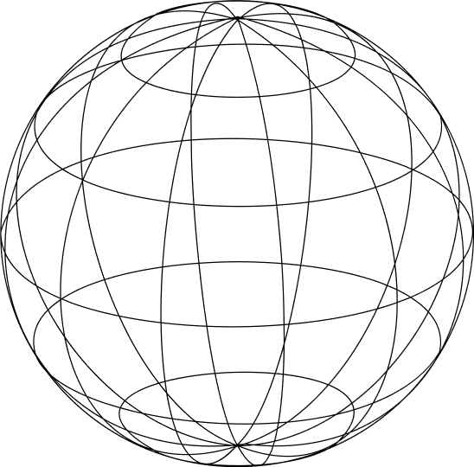

What are Partial Differential Equations?
A Partial Differential Equation is a differential equation containing partial derivatives of the dependent variable with more than one independent variable.
A PDE for a function u(x1,……xn) is an equation of the form
The simple PDE is given by;
∂u/∂x (x,y) = 0
The above relation implies that the function u(x,y) is independent of x which is the reduced form of partial differential equation formula stated above.

Slide 3
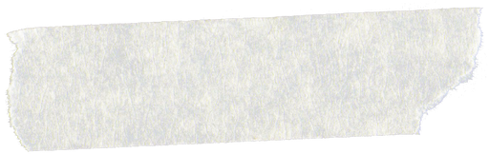
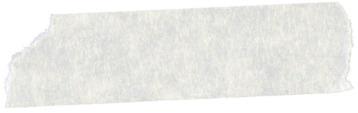

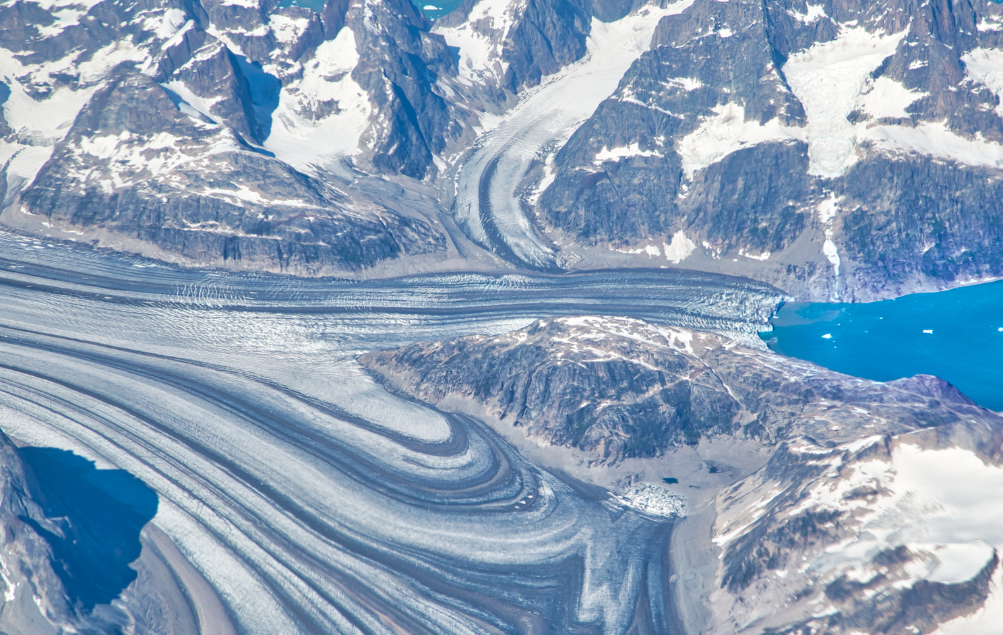
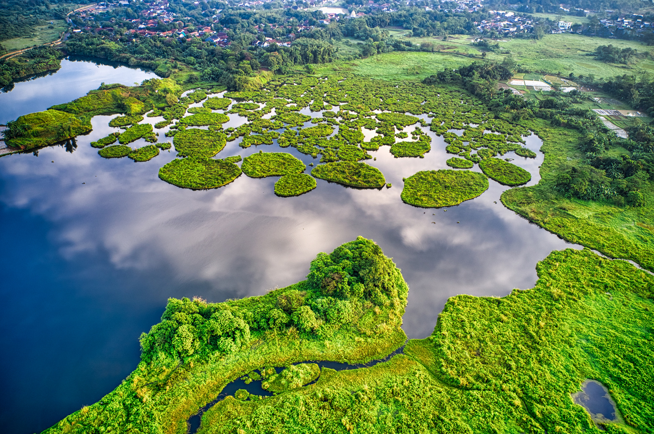
Applications in Geography
HYDROLOGY
BIOGEOGRAPHY

Slide 4


HYDROLOGY
Hydrology is the study of water in the Earth's system, including its distribution, movement, and quality.
Partial differential equations are used in hydrology to model the behavior of water in different environments, such as rivers, lakes, groundwater, and the atmosphere.
PDEs can also be used to model other hydrological processes, such as the movement of water through the atmosphere, the formation and movement of snow and ice, and the evaporation and infiltration of water in soil.

Slide 5
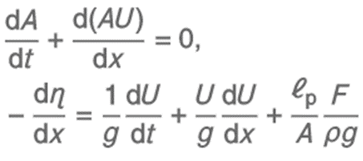
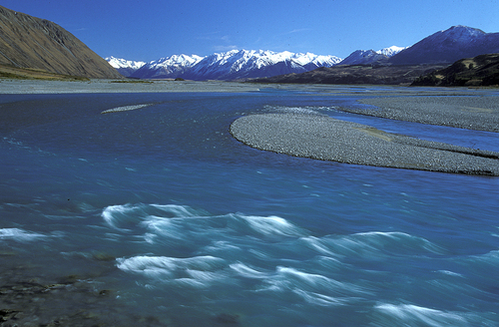


One of the most common PDEs used in hydrology is the Saint-Venant Equations, which describe the flow of water in an open channel, such as a river.
These equations are based on the principles of conservation of mass and momentum and consider factors such as the slope of the river channel, the roughness of the channel bed, and the width of the river.
continuity
momentum
where,
A is the channel cross-sectional area,
U is the velocity,
η = H + zb with H as the water depth and zb as the bottom elevation,
ρ is the density of water,
ℓp is the wetted perimeter,
F is the frictional force per unit bottom area along the channel,
g is gravity,
t is time.
Saint - Venant
Equations

Slide 6
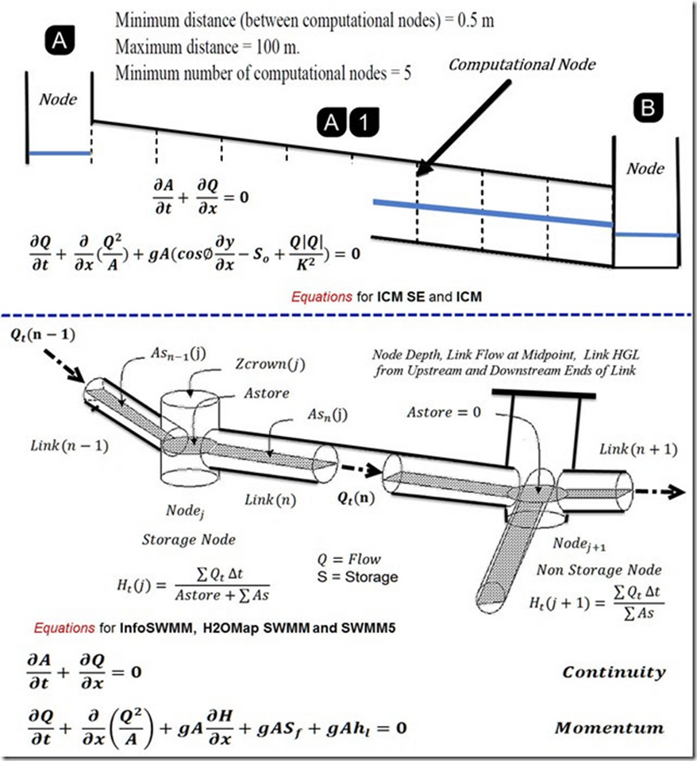
The solutions to the Saint-Venant equations can be used to predict the behavior of rivers under different conditions, such as changes in water flow or changes in the river channel due to erosion or sedimentation.
These predictions can be used to design structures such as dams, embankments, and bridges, as well as to manage water resources for irrigation, drinking water, and other purposes.

Slide 7
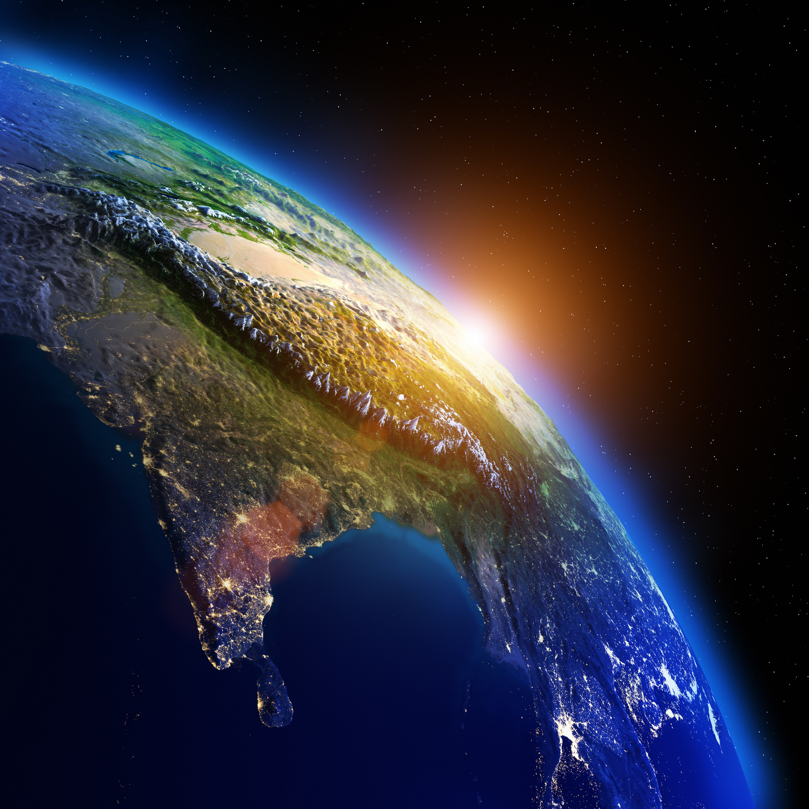
BIOGEOGRAPHY
Biogeography is the study of the distribution of species and ecosystems across the Earth's surface, and the processes that determine these distributions.
Partial differential equations are used in biogeography to model the dynamics of vegetation, and to understand the factors that control the distribution and abundance of plant species in different ecosystems.

Slide 8

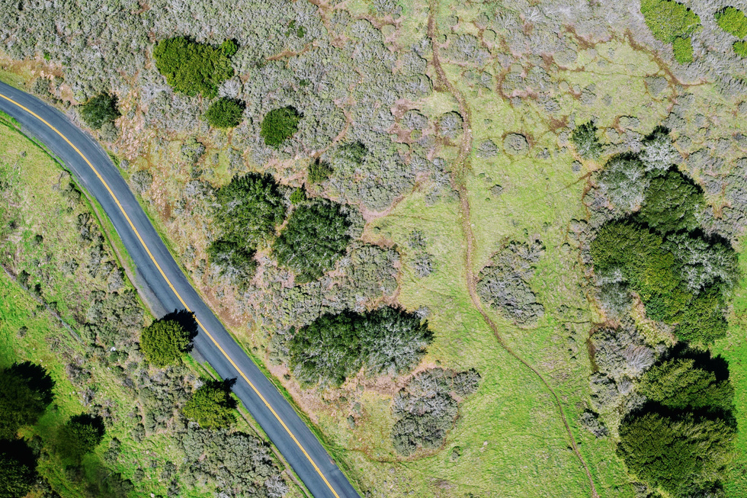
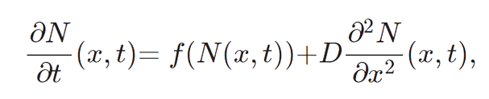
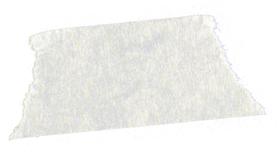

One of the most used PDEs in biogeography is the Reaction-Diffusion Equation, which describes the change in the concentration of a species over time and space due to the interactions between individual plants and their environment.
This equation considers factors such as growth, death, and dispersal of plants, and can be used to predict the distribution and abundance of plant species under different environmental conditions.
Reaction - Diffusion
Equation
where,
N(x,t) is the population density,
D is the diffusion coefficient, a proportionality constant between the population flux and the gradient in the achieved population density.

Slide 9

The solutions to the reaction-diffusion equation can be used to predict the distribution and abundance of plant species under different environmental conditions, such as changes in temperature, precipitation, or soil type.
These predictions can be used to design interventions such as reforestation or habitat restoration, as well as to assess the potential impacts of climate change on ecosystems.

Slide 10
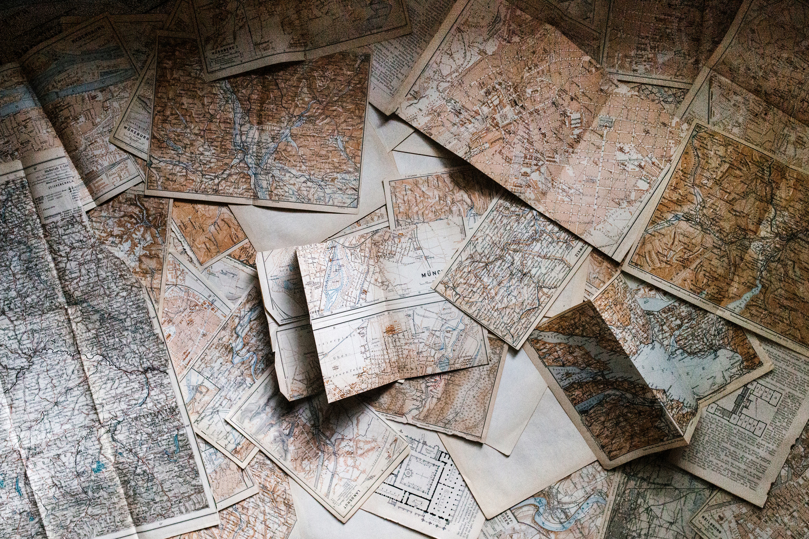

References
Mwangi, J. K., Buytaert, W. A., Western, A. W., Dadson, S. J., & Whitehead, P. G. (2019). Hydrological response to climate change for a data-scarce region using the Soil and Water Assessment Tool (SWAT): the case of the Upper Ewaso Ng'iro North Basin, Kenya. Hydrology and Earth System Sciences, 23(3), 1281-1297. doi: 10.5194/hess-23-1281-2019. https://hess.copernicus.org/articles/23/1281/2019/#section1.
"Updated - Innovyze St Venant Solutions for InfoSWMM, InfoSewer, H2OMap SWMM and InfoWorks ICM and InfoWorks ICM SE." SWMM456. Accessed March 14, 2023. https://www.swmm456.com/2016/01/.
Mao, X., Li, J., Zhang, Y., Huang, J., & Li, J. (2021). Cities on the Coast and Patterns of Movement between Population Growth and Diffusion. Entropy, 23(8), 1041. doi: 10.3390/e23081041. Available online: https://www.ncbi.nlm.nih.gov/pmc/articles/PMC8391108/.
"Partial Differential Equation - Definition, Types, Order, Examples." BYJU'S. Available online: https://byjus.com/maths/partial-differential-equation/.

Slide 11
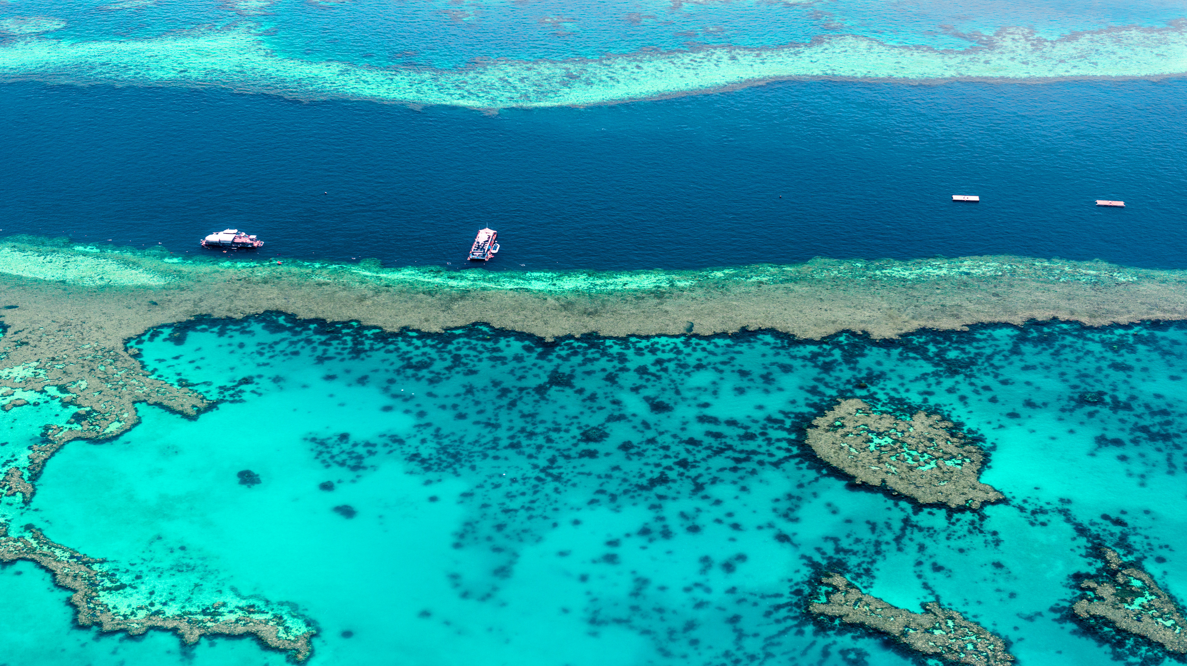
Thank You

